Slide 1

Critical Design Review
RoboRaiders

Slide 2
Table of Contents
Table of contents
The overall design and how it’s divided------------------------------Slide 3
Requirements and Goals-------------------------------------------------Slide 4
Manufacturing--------------------------------------------------------------Slide 7
Understanding the Risks------------------------------------------------Slide 11
The overall design and how its divided
Requirements and Goals
Manufacturing
Understanding the Risks

Slide 3
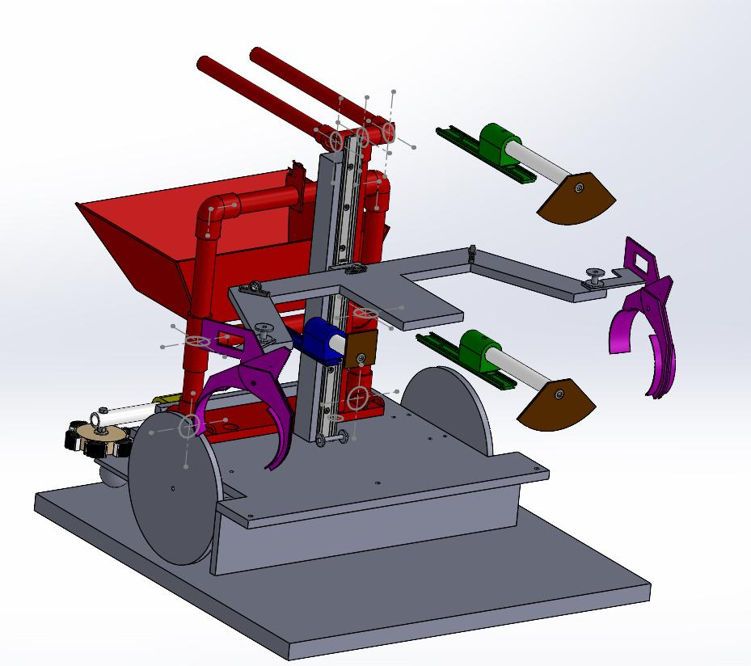
The Overall Design- Hardware and Software
Software: We are currently using an arcade drive system to move our robot during normal user control. We use RobotC for all of our robot programming. As for our sensors we have a working line follower, using two IR sensors mounted in the front of our robots base. We are currently researching uses for the limit switch to return us back to the user control once the line following ceases
Hardware: We are using a two wheel design with three modular parts. The first modular part is for the brain biopsy to score those available points. The second modular part is the coronary artery bypass vein arms. The third modular part is the plague removal scoop tool.
Table of contents
overall design
Requirements and Goals
Manufacturing
Understanding the Risks

Slide 4

Requirements
Performance Requirements
-How it must be
Some of the depository equipment we have on our robot needs to be able to change in height to efficiently perform its tasks as well as extend its width and meet requirements
Table of contents
The overall design and how its divided
Stated Requirements
Best Requirements
Meet robot specifications
Using the autonomous to complete brain biopsy
Requirements and Goals
Derived Requirements- requirements put on yourself and your robot
We want to complete the brain biopsy using autonomous
Aim to complete the angioplasty
Coronary artery bypass
Manufacturing
System Requirements
-Software needs to be able to handle several inputs
-IR sensors used to track the lines
Understanding the Risks
Notes:
The objective our team has been equipped with is the ability to fully design and construct a field robot capable of accomplishing multiple tasks at once. The first task we are asked of is using our field robot to use autonomous to complete the brain biopsy segment. Next we will work on a robot that will be able to collect as many things as we can, but the main things we need to prioritize are

Slide 5
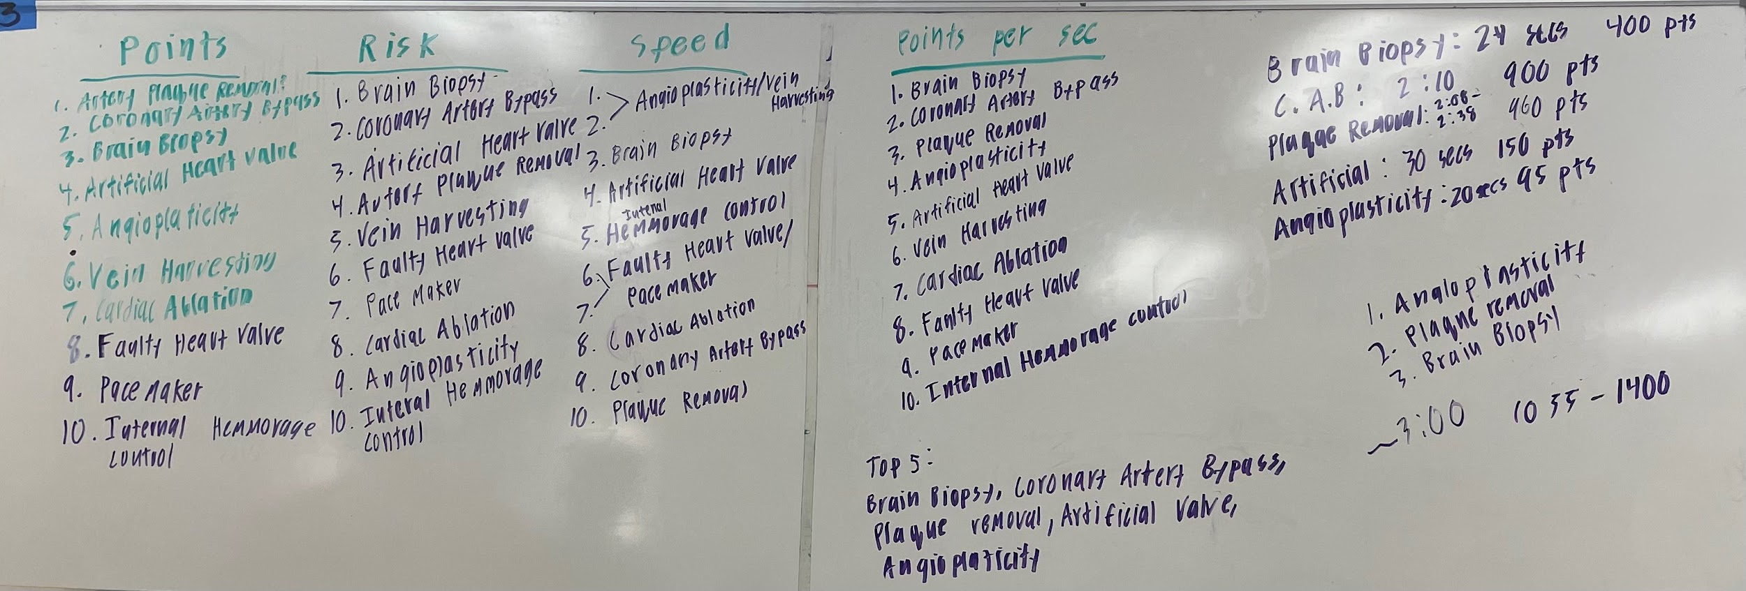
Table of contents
The overall design and how its divided
Requirements and Goals
Manufacturing
We used mathematics to figure out how long each procedure would take according to our robot speed, and how that would relate to its point yield to figure out what procedures we would need to manufacturer mechanisms for.
Understanding the Risks

Slide 6
Brain Biopsy
Prototype and design of the poking mechanism
Poke sticks
Table of contents
The overall design and how its divided
Requirements and Goals
Understanding the Risks
Manufacturing

Slide 7
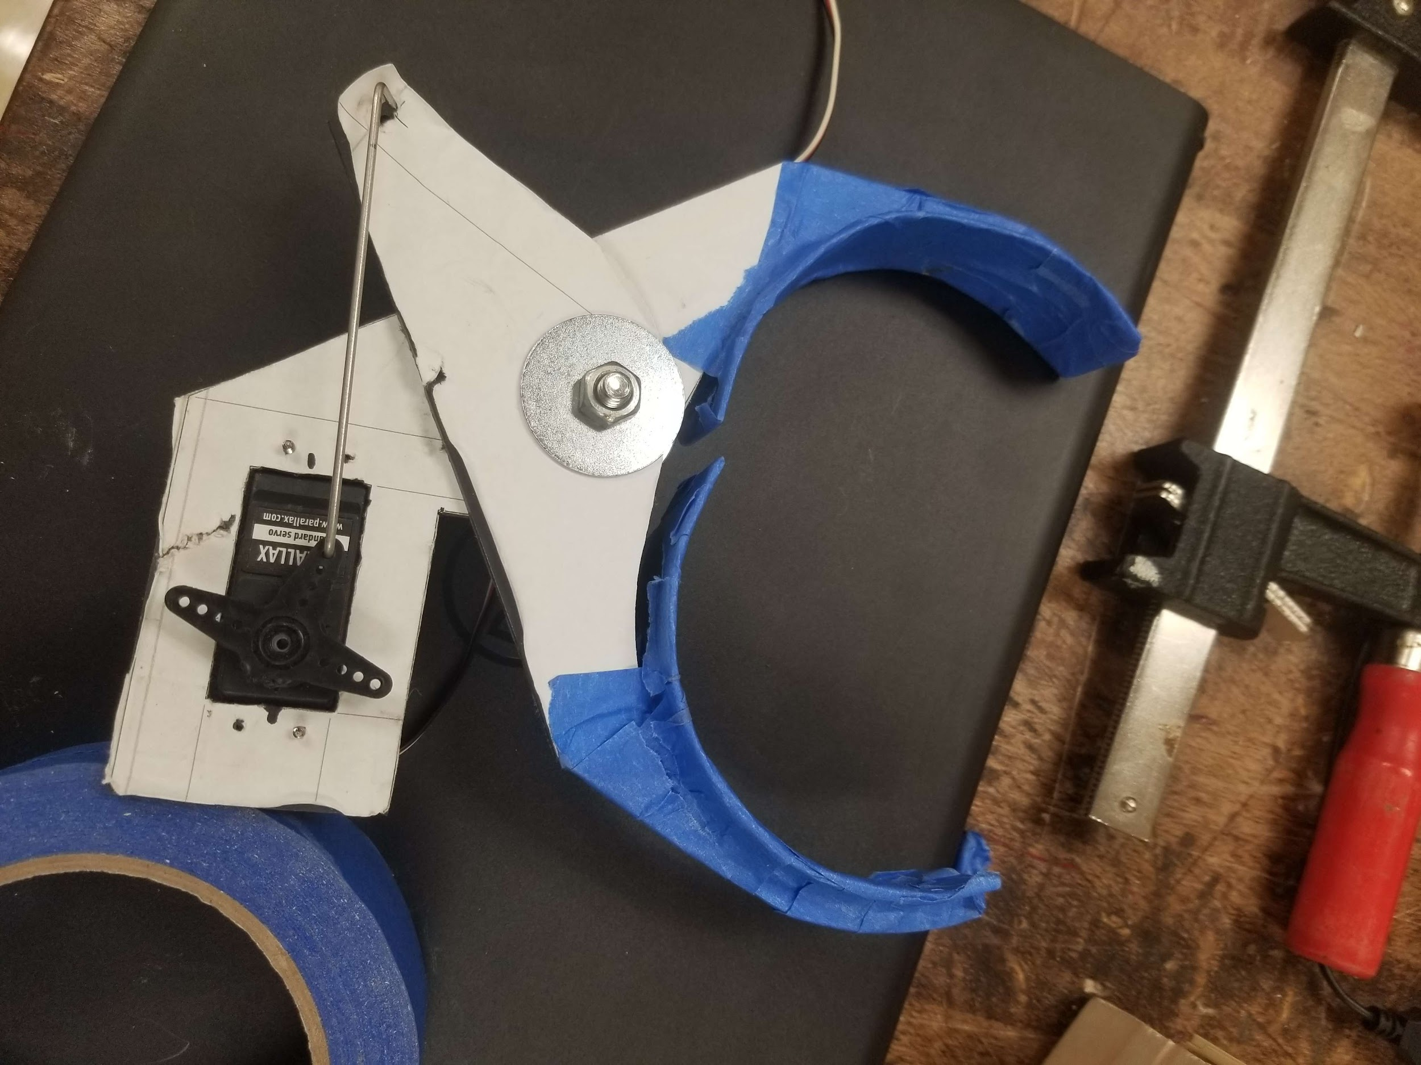
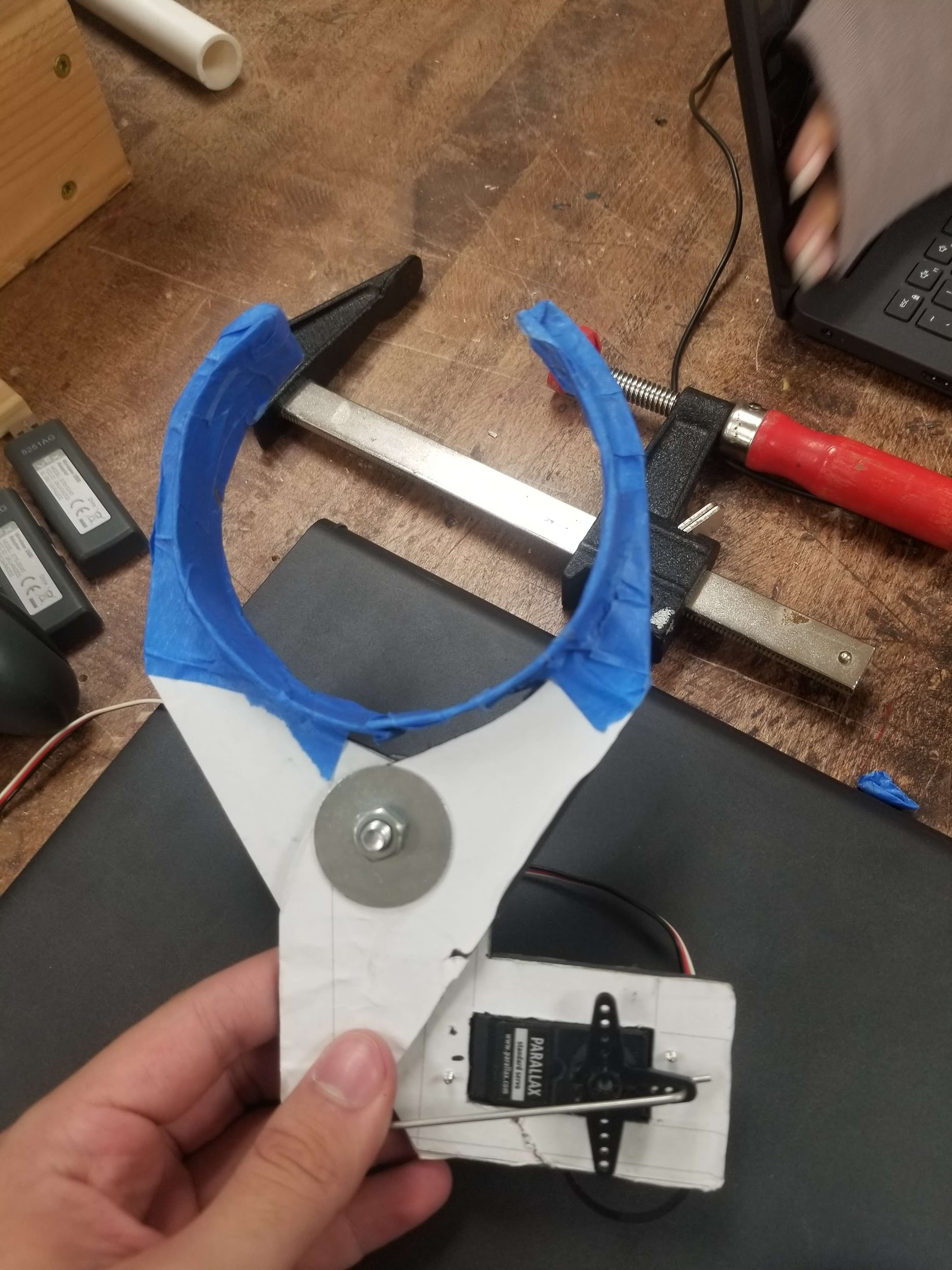
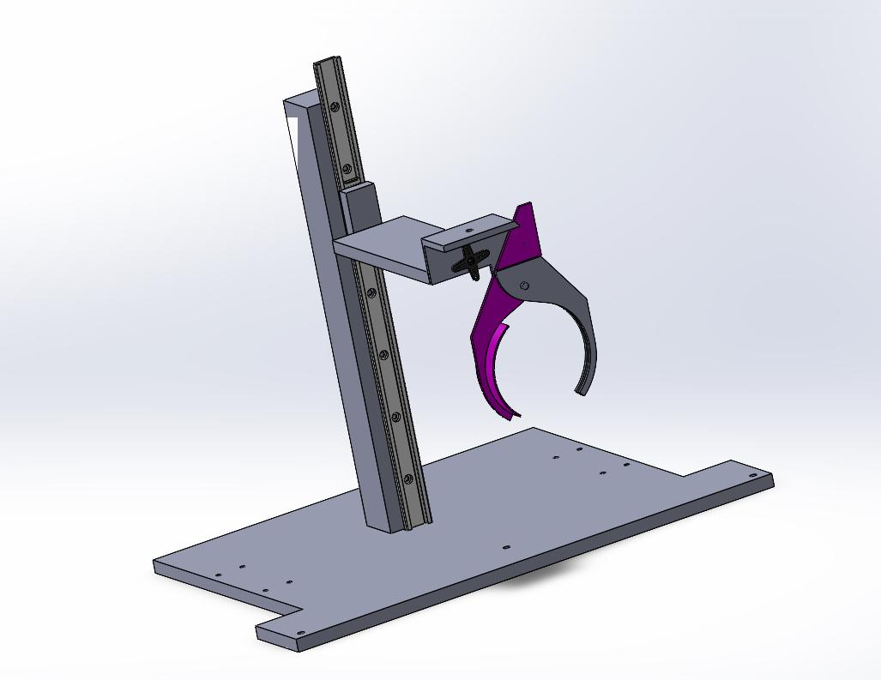
Coronary Artery Bypass Arm
Table of contents
We hold the two ends of the vein using two of these arms. They are controlled by strings and some joints.
The overall design and how it’s divided
Requirements and Goals
Manufacturing
Understanding the Risks
Most recent CAD design of our game robot

Slide 8
Plaque Removal
The tool will be placed on the main pillar so that it can move vertically as well as horizontally to get the tool to where it needs to be.
Table of contents
The overall design and how its divided
Requirements and Goals
Manufacturing
The tool will be used to scrape the plaque into the red basin. The placement is to be determined.
Understanding the Risks

Slide 9
Potential risks
Table of contents
Trying to get points blind
Autonomous section not working
One of the items falling in an unexpected way
The overall design and how its divided
Specialized driver training
Stable and proportionally built parts.
Specialized base design
Lots of code testing and changes as necessary
Improve camera mobility
Requirements and Goals
Manufacturing
Understanding the Risks
Risk Minimization

Slide 10



Questions, Comments, Concerns?

